Slide 1
Object Oriented Analysis and Design
Use Case Diagram

Slide 2
Use Case diagram
A use case diagram is a graphical depiction of the user’s interaction with a system and interactions among the elements of a system.

Slide 3
Use Case diagram
Represent functions of a system behavior as user views
Depicts the interactions between the system and external systems and users.
Graphically describes who will use the system and in what ways the user expects to interact with the system

Slide 4
Use Case diagram
Use case diagram illustrates
A set of use cases for a system
The actors of these use cases
Relations between the actors and use cases
Relations among the use cases.
System boundary

Slide 5
Use Case Diagram Components
Actor
Inheritance
Use case
Inclusion Of a
Use case by Another
Actor to Use case
Association
<<
extends
Extension of a
Use case by Another
>>
Notes
System
Boundary

Slide 6
Actor
Type of users of the system or external systems that the system interacts with.
Actor may anything that needs to interact with the system to exchange information
User
Separate computer system
External device

Slide 7
Actor Variations
Primary actor Vs. secondary actor
Primary
The first or main Actor who uses the system
The main Actor who benefits from the system
e.g. Customer, Patient, Doctor
Secondary Actor
The Actor who derives indirect benefits from or uses the system
e.g. Branch manager
Depends on Perspective

Slide 8
Actor Variations
Direct actor Vs. indirect actor
Direct
E.g. Teller
Indirect
E.g. Customer

Slide 9
Use Case
System functionality to complete a process
Describe what a system does

Slide 10
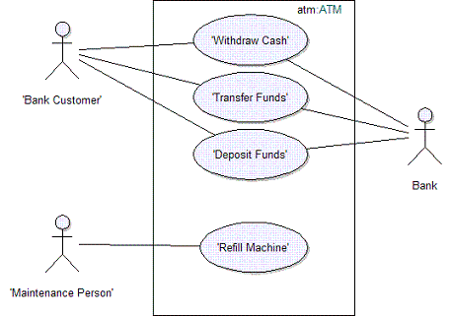
Use Case Diagram Example

Slide 11
Identifying Use Cases
Actor based
Specify the actors which will use the system and which other systems must interact with it.
For each actor, identifying the processes they initiate or participate
Event based
Identify the external events that a system must respond to
Relate the events to actors and use cases

Slide 12
Advantages of Use Case diagram
Easy to understand by non technical people
Facilitate encouraging user involvement
Used to gathering system requirements from users
Used to describe a new design to stakeholders
Helpful in identifying project scope

Slide 13
Scenario
The scenario is an ordered sequence of interactions between the actor(s) and the system to accomplish a goal.
Scenario consists of
Normal flow
Alternate flow
Sub flows
Exceptions

Slide 14
Normal Flow
The basic flow cover events what "normally" happens when the use case is performed.
Known as best case scenario
Ex.
Normal Flow: | 1. Customer inserts the bank card. 2. Customers enters password. 3. System verifies password. 4. System presents a list of transaction types that the customer may conduct. 5. Customer selects a type of transaction.

Slide 15
Sub Flow
Sub-flows elaborate the details of the steps in the normal flow
Ex.
Normal Flow: | 1.Registration clerk enter or update personal data
Sub Flows: | 1.1 The registration clerk enters the Social Security Number of the new patient. 1.2 The registration clerk enters or updates patient’s address. 1.3 The registration clerk enters or updates patient’s phone number. 1.4 The registration clerk enters or updates the name, the address and the phone number of the patient’s closest relative.

Slide 16
Alternate Flow
Alternate flow elaborate optional behaviors
Ex.
Normal Flow: | 1.Registration clerk enter or update personal data
Sub Flows: | 1.1 patient is new:. Reception clerk directs the patient to registration. 1.2 Patient is not new but personal or insurance data has changed. Reception clerk directs the patient to registration. 1.3 Patient has lost the hospital ID card. Reception clerk directs the patient to registration.

Slide 17
Exceptions
Exceptional flow elaborate failures which not achieving the use case's goal

Slide 18
Narratives
Narration is a textual representation of the course of events encountered when an actor is interacting with the system

Slide 19
Narratives

Slide 20
Relationships
Association
Extend
Include
Depends on
Inheritance
Generalization

Slide 21
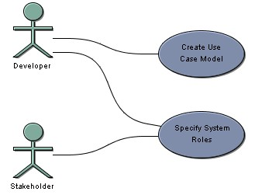
Relationships
Associations
Drawn between actors and use cases to show that an actor carries out a use case
Solid line connecting the actor and the use case

Slide 22
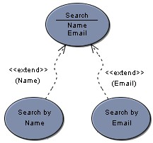
Relationships
Extend
Extends the functionality of the original use case
Arrow headed (either solid/dashed) line
Shows optional behavior

Slide 23

Example

Slide 24
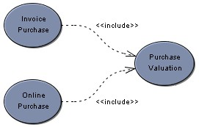
Relationships
Include
Depict the Relationship between an abstract use case and it included use case.
Arrow headed (either solid/dashed) line

Slide 25
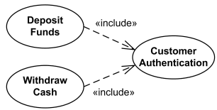
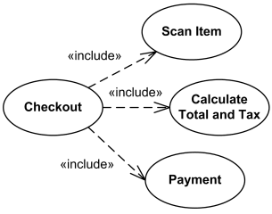
Example

Slide 26
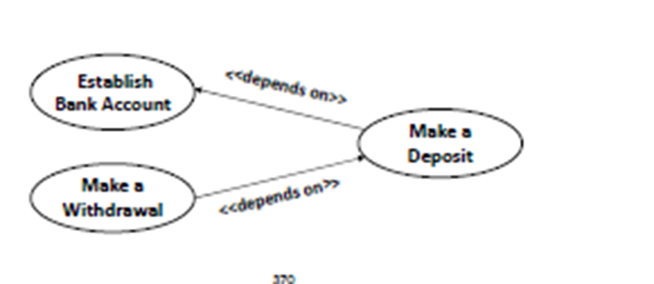
Relationships
Depends on
Indicating that one use case cannot be performed until another use case has been performed

Slide 27
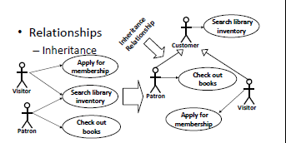
Relationships
Inheritance
Relationship between actors
Simplify the drawing when an abstract actor inherits the role of multiple actors

Slide 28
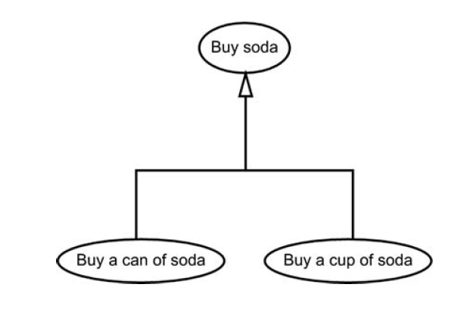
Relationships
Generalization
Relation between use cases
Relation between abstract use case and specialized use case
Use arrow headed solid line

Slide 29
The Process of Modeling Use Cases
Step 1: Identify business external systems or users
Actors
Step 2: Identify Business Requirements
Use Cases
Step 3: Construct Use‐Case Model
Diagram
Step 4: Document Business Requirement
Use‐case Narratives

